Slide 1
AI-Powered Delivery Post Office Identification System
PIP104 University Project-II
Final Review
Batch Number: CSE-G54
20211CSE0495 | ANANTHANENI GURUPRASAD
20211CSE0803 | BOYAPATI MEGHANA
20211CSE0885 | EDURU GOWTHAMI
20211CSE0320 | POTHURAJU CHANDANA
Under the Supervision of,
Dr. Jayavadivel Ravi
Professor / Associate Professor / Assistant Professor
School of Computer Science & Engineering
Presidency University
Roll Number | Student Name

Slide 2
Introduction
Postal services are vital for logistics and communication, but accessing them via digital tools remains underdeveloped. This project introduces a Kotlin-based Android app integrating AI (Gemini) and geo-mapping to help users easily locate nearby post offices, lodge complaints, Search Post Office Names, and interact with postal services efficiently.

Slide 3
Problem Statement
Many users face difficulties in locating nearby post offices, filing complaints, or receiving updates due to the absence of centralized, AI-driven mobile systems. Current tools lack interactive mapping and real-time query resolution features, leading to inconvenience and limited engagement.

Slide 4
Literature Review
S.NO | YEAR | AUTHORS | TITLE | OUTCOMES
1 | 2016 | Koesdwiady, Soua & Karray | Improving Traffic Flow Prediction With Weather Info in Connected Cars | Enhanced delivery routing through weather-based traffic prediction using deep learning
2 | 2017 | R. Mehta & T. Joshi | Integration of Mobile GIS for Urban Services | Demonstrated how mobile GIS improved access to urban services, especially in remote areas.
3 | 2018 | S. Lee & T. Kim | Geo-Mapping Interfaces for Civic Use | Highlighted advantages of mobile geo-mapping interfaces in urban public services.
4 | 2019 | A. Banerjee & S. Rao | Complaint Management Systems: A Digital Approach | Showed how complaint handling apps improve administrative responsiveness and feedback loops.
5 | 2020 | Kirimtat, Krejcar, Kertesz & Tasgetiren | Future Trends and Current State of Smart City Concepts | Reviewed smart city innovations, emphasizing AI and mobility services.

Slide 5
Literature Review
S.NO | YEAR | AUTHORS | TITLE | OUTCOMES
6 | 2021 | A. C. de Araujo & A. Etemad | End-to-End Prediction of Parcel Delivery Time With Deep Learning | Enabled accurate delivery time predictions for smart city logistics.
7 | 2022 | Chen, Ulmer & Thomas | Deep Q-learning for Same-Day Delivery with Vehicles and Drones | Introduced an AI-based system to optimize same-day deliveries using drones and vehicles.
8 | 2023 | J. Patel & N. Kumar | Kotlin-Based App Development for Government Services | Validated Kotlin’s use for performance, modularity, and user interface in public service apps.
9 | 2024 | Chen, Men, Fuster & Osorio | AI in Logistics Optimization with Sustainable Criteria | Focused on AI tools in sustainable logistics optimization.
10 | 2025 | S. Agrawal & L. Banerjee | AI-Driven Dynamic Routing for Government Delivery Systems | Proposed a dynamic routing algorithm using AI to improve government delivery response efficiency.

Slide 6
Findings For Literature Survey
S.NO | YEAR | AUTHORS | IMPLEMENTATION | WHAT PROBLEM THEY FACED
1 | 2016 | Koesdwiady, Soua & Karray | Used weather data with deep learning for traffic prediction | Existing traffic models failed during adverse weather conditions
2 | 2017 | R. Mehta & T. Joshi | Integrated mobile GIS to access urban services | Limited access to public services in remote or rural areas
3 | 2018 | S. Lee & T. Kim | Designed geo-mapping interfaces for public apps | Users had difficulty visualizing service locations without interactive maps
4 | 2019 | A. Banerjee & S. Rao | Developed a digital complaint management system | Traditional systems were slow, unstructured, and lacked tracking
5 | 2020 | Kirimtat et al. | Surveyed smart city technologies focusing on AI and mobility | Lack of cohesive AI integration in civic service systems
6 | 2021 | Araujo & Etemad | Applied deep learning for delivery time prediction in smart cities | Delivery times were inaccurate due to traffic unpredictability
7 | 2022 | Chen, Ulmer & Thomas | Used deep Q-learning for optimizing drone/vehicle delivery routes | Difficulty optimizing same-day delivery under changing demands

Slide 7
Findings For Literature Survey
S.NO | YEAR | AUTHORS | IMPLEMENTATION | WHAT PROBLEM THEY FACED
8 | 2023 | Patel & Kumar | Developed Kotlin-based public service apps | Previous tech stacks weren’t mobile-optimized and lacked UI responsiveness
9 | 2024 | Chen, Men, Fuster & Osorio | Reviewed AI in sustainable logistics systems | Balancing sustainability with logistics efficiency was challenging
10 | 2025 | Agrawal & Banerjee | Created AI-based dynamic routing for government deliveries | Static routes delayed responses in government service logistics

Slide 8
Proposed Method
Develop an Android app using Kotlin with:
AI chatbot (Gemini) for user support.
Geo-mapping of post office locations.
Admin panel for updates and complaint management.
Search Post Offices.
Direct navigation, calling, and interactive UI for users.

Slide 9
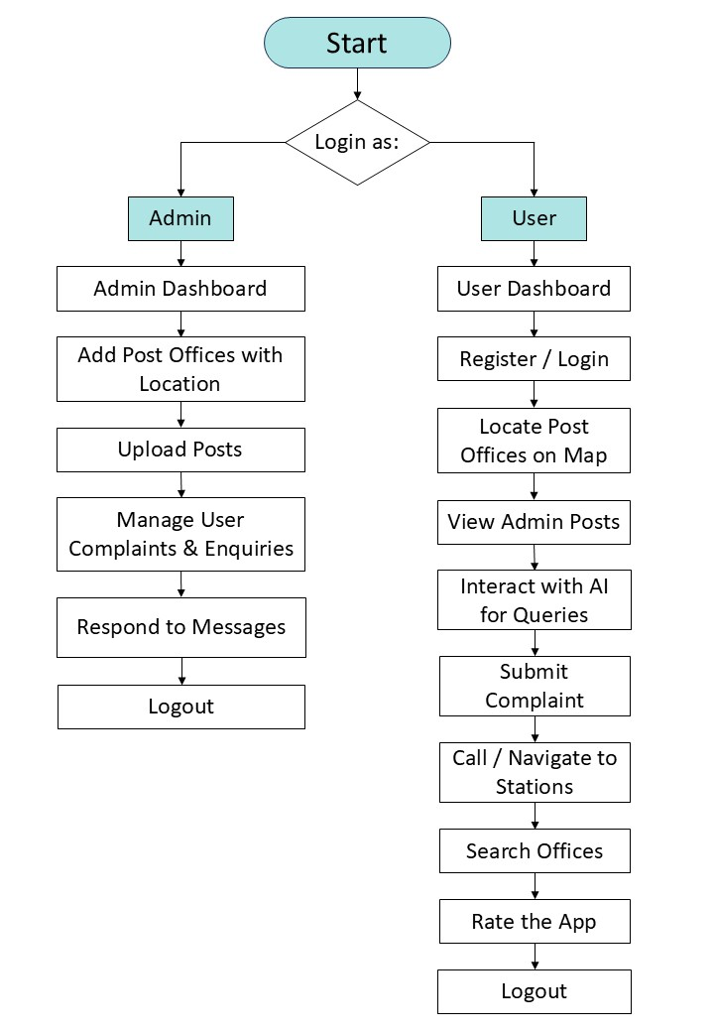
Project flow

Slide 10
Objectives
Help users locate nearby post offices using real-time geo-tagging.
Search Post Offices.
Simplify complaint and feedback submission.
Use AI to assist users with postal queries.
Improve user experience with a mobile-first approach.

Slide 11
Methodology
Frontend: Kotlin (Android Studio)
Backend: MySQL for database management
AI Integration: Gemini chatbot
Features:
Location services for geo-mapping
Secure login for admin/user
Complaint handling
Post viewing and interaction system

Slide 12
Timeline of Project
Project Duration:
4 months (16 weeks)
Phases:
Literature, Identification Modules, Implementation Modules, Testing of Modules, Publishing Preparation of Papers, and Maintenance.
Key Milestones:
Week 1-2: Literature
Week 3-5: Identification Modules
Week 5-9: Implementation Modules
Week 9-12: Testing of Modules
Week 12-13: Publishing Preparation of Papers
Week 14-16: Maintenance

Slide 13
Expected Outcomes
Improved postal accessibility through AI-driven geo-mapping
Instant AI-powered support for user queries via chatbot
Centralized complaint management with faster resolution
Real-time service updates and notifications
Direct, streamlined communication between users and admins
Interactive features: map navigation, in-app calling, and ratings
Centralized admin dashboard for managing offices and feedback
Mobile-first, user‑friendly interface for on‑the‑go access
Efficient service delivery with optimized routing
Continuous improvement driven by user feedback and analytics

Slide 14
GitHub Link
https://github.com/GuruPrasadAnanthaneni/Postal_AI_App

Slide 15
Conclusion
The AI-Powered Post Office Identification System modernizes the way people access postal services by combining geolocation, AI, and mobile app convenience. It enhances public access, ensures timely updates, Search Post Offices and simplifies support communication, ultimately fostering a smarter postal ecosystem.

Slide 16
References
[1] Koesdwiady, R. Soua, and F. Karray, "Improving Traffic Flow Prediction With Weather Information in Connected Cars: A Deep Learning Approach," IEEE Transactions on Vehicular Technology, vol. 65, no. 12, pp. 9508–9517, Dec. 2016.
[2] Kirimtat, O. Krejcar, A. Kertesz, and M. F. Tasgetiren, "Future Trends and Current State of Smart City Concepts: A Survey," MDPI Applied Sciences, vol. 10, no. 18, pp. 1–21, May 2020.
[3] A. C. de Araujo and A. Etemad, "End-to-End Prediction of Parcel Delivery Time With Deep Learning for Smart-City Applications," arXiv preprint arXiv:2009.12197, May 2021. [Online].
[4] Chen, M. W. Ulmer, and B. W. Thomas, "Deep Q-learning for Same-Day Delivery with Vehicles and Drones," arXiv preprint arXiv:1910.11901, May 2022.
[5] Chen, Y. Men, N. Fuster, and C. Osorio, "Artificial Intelligence in Logistics Optimization with Sustainable Criteria: A Review," IEEE Access, Oct. 2024.

Slide 17
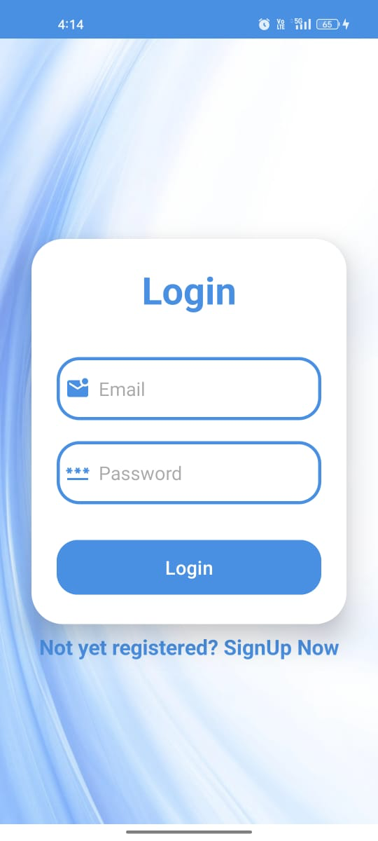
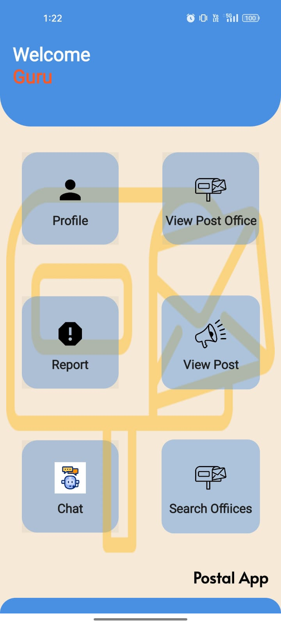
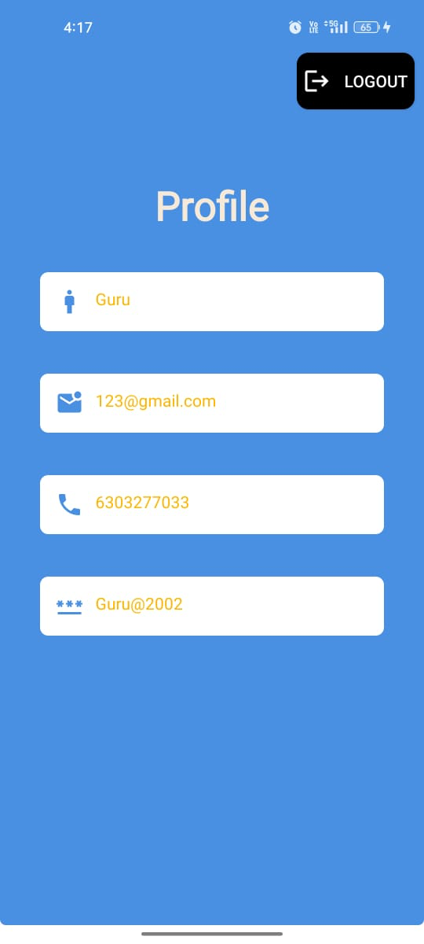
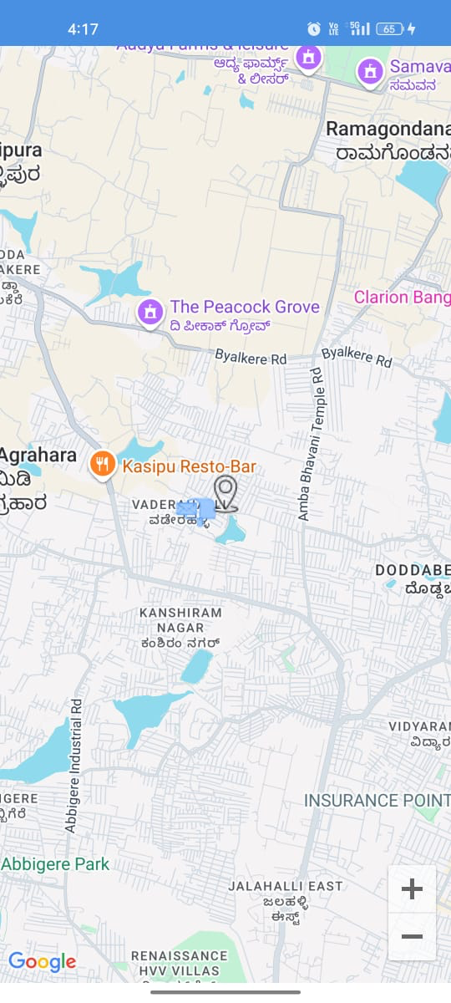
Outputs

Slide 18
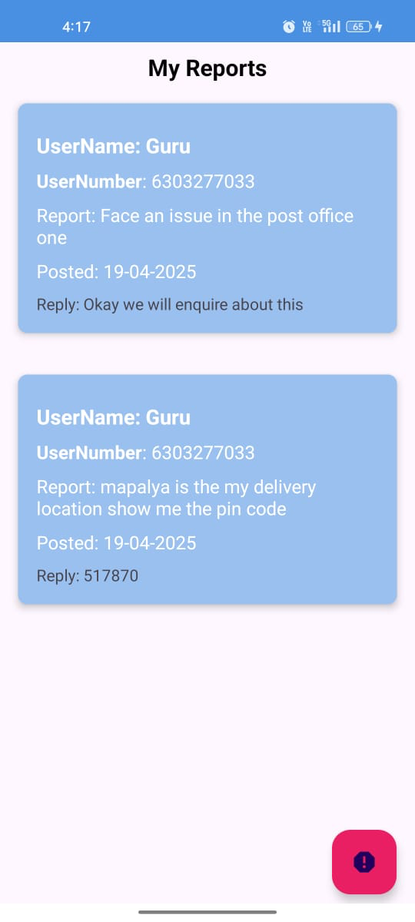
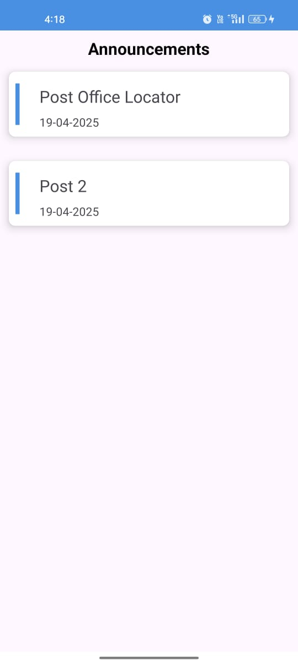
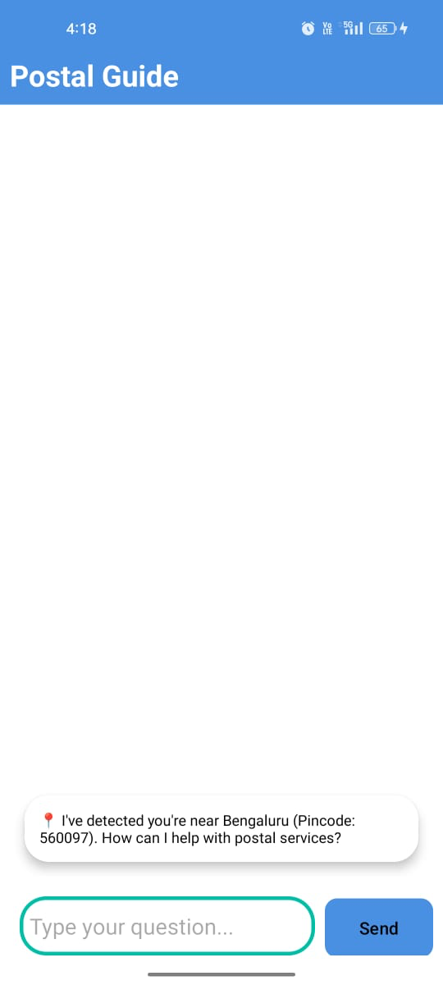
Outputs

Slide 19
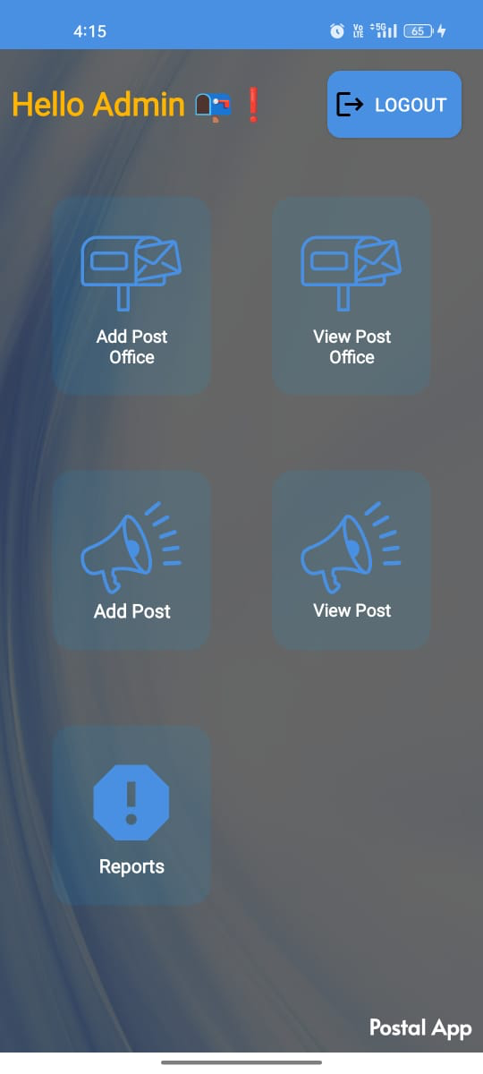
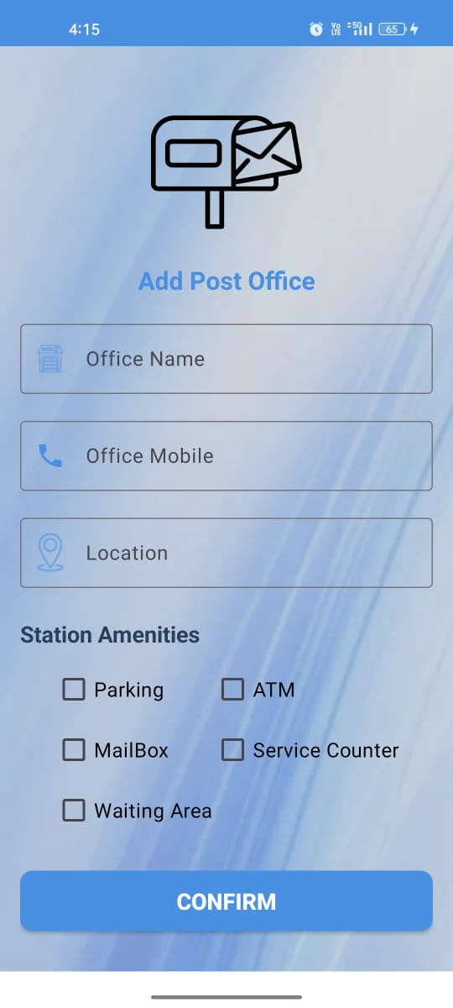
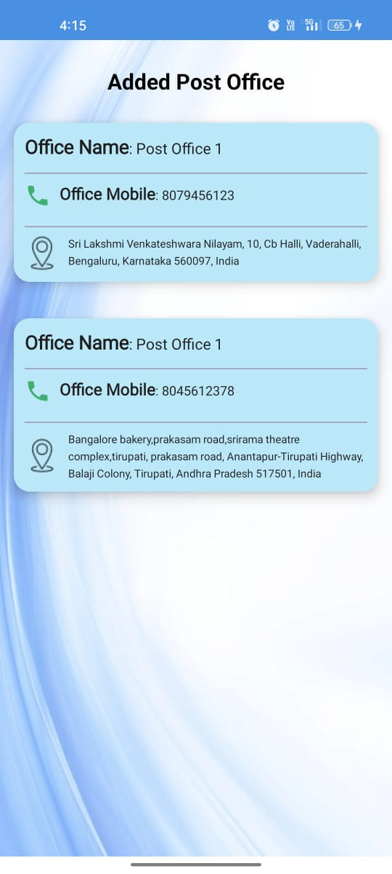
Outputs

Slide 20
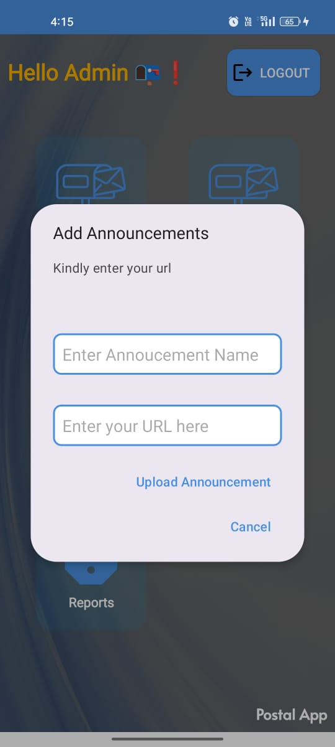

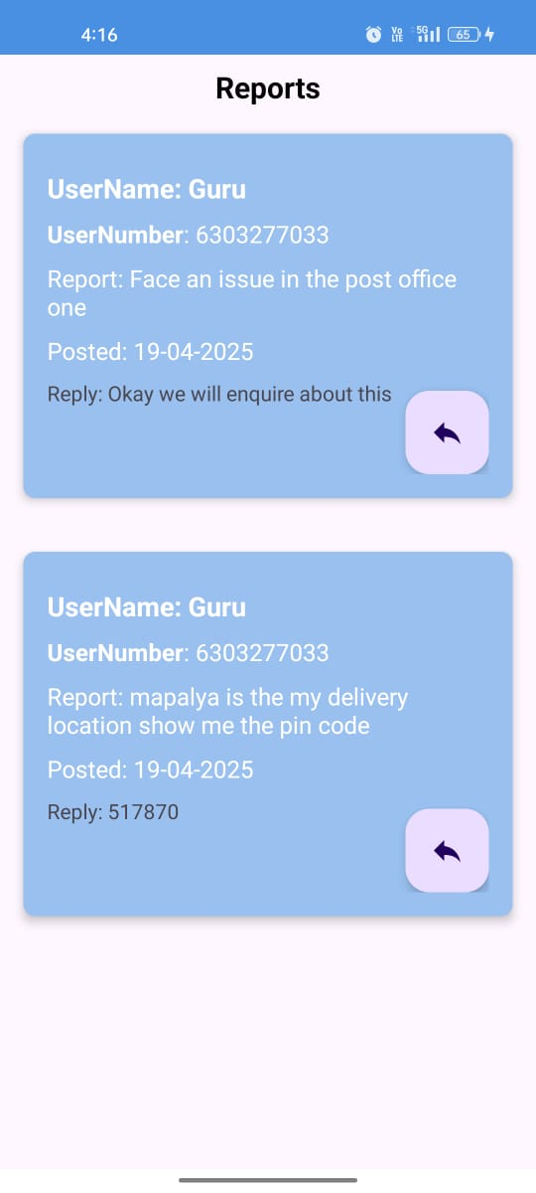
Outputs

Slide 21

Sustainable Development Goals

Slide 22


